Slide 1
Surviving Bear Markets
RBCx Capital

Slide 2
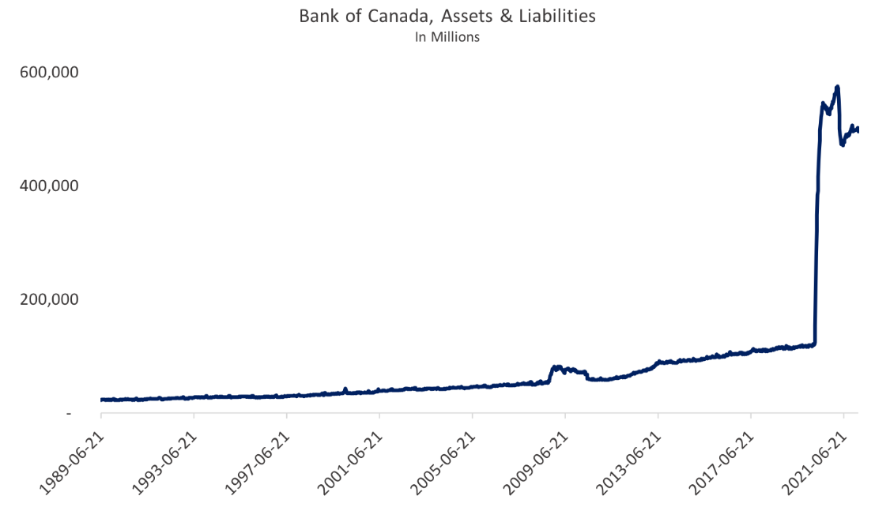
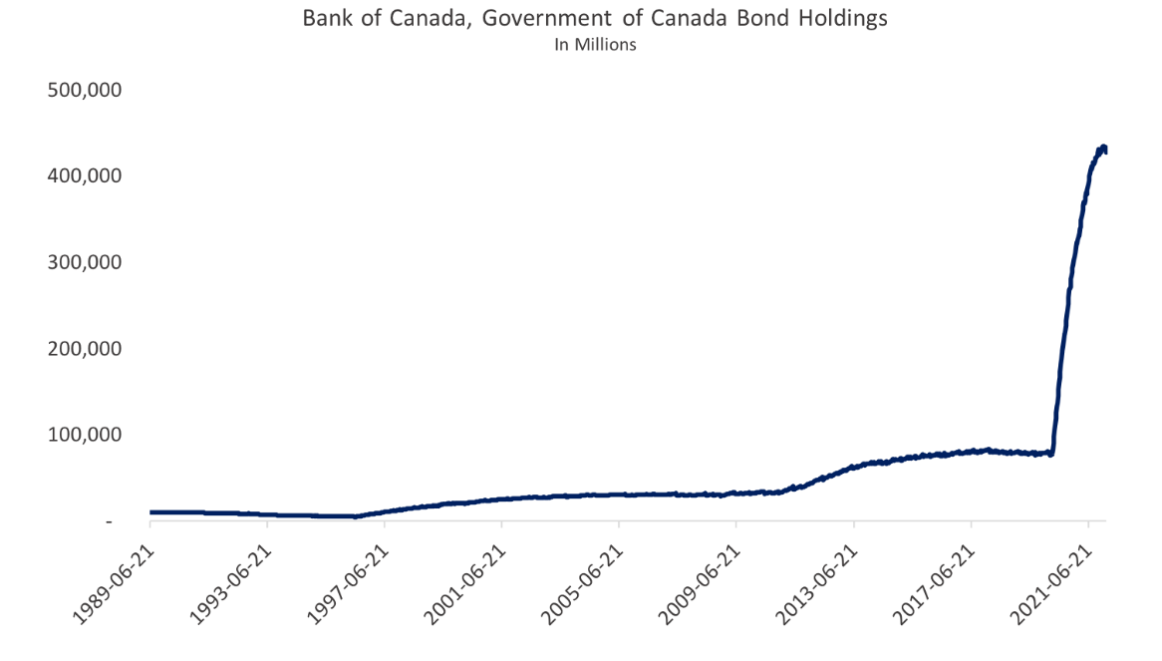
How Did We Get Here?
We are transitioning from an environment of unprecedented monetary expansion to one of equally unfamiliar monetary contraction. The scale and scope of the quantitative easing programs implemented by the Bank of Canada and the Federal Reserve in response to the pandemic meaningfully contributed to an unnatural inflation in tech asset values.

Slide 3
Carryover Dry Powder
Luckily, venture capital has a very long tail, and the funding ecosystem will take a long time to respond to the new macro realities.
Dry Powder ($)
Undeployed US VC capital was an estimated $223B in 2021
In the recently released 2022 Investor Survey published by Pitchbook & Collision, when investors were asked to evaluate external pressures facing the VC ecosystem such as public market volatility, increasing interest rates and talent market shifts, nearly half (45%) of respondents disagreed that their investment activity will markedly decrease from recent years.

Slide 4
What Does This All Mean?
The next 18 to 24 months will be characterized by a flight to quality. VCs have capital to deploy, but they will be markedly shifting their priorities and strategies.
Re-Focusing on fundamentals
More extensive due diligence
Applying greater discipline in relation to capital allocation
Emphasis on gross margin and capital efficiency

Slide 5
Proactive Fundraising
Transitioning to proactive and anticipatory fundraising is critical. In tandem, take tangible steps to reduce burn and extend runway. This allows you to maintain optionality and to maximize the probability of fundraising in a more hospitable macro environment.
Focus on constantly sharing your story – don’t wait until you’re in a pitch to do this.
Develop strong relationships with VCs well before you think you’ll be fundraising.
Stay in touch with funds even when you’re not fundraising. Keep them excited about what you’re doing.
Maintain a longitudinal focus on your network. Find creative ways to stay in contact.

Slide 6
Proactive Fundraising
Maintain a pipeline of relevant high-conviction investors. Ensure that you are engaging with the right investors, and that you are maintaining an ongoing dialogue. In bear markets investors revert back to familiarity.
Investor Alignment
Longitudinal Engagement
Look for VCs that have already invested in your geography to make the best use of your time.
Look for VCs whose investment thesis and focus matches what you’re building.
Understand the portfolio construction of the funds, and which stage they invest in.
Most VCs won’t invest in startups that directly compete with their portfolio.
Leverage public databases for quick access to relevant information to build a strong pipeline.
Make sure your dataroom & presentations are constantly evolving and remain up to date.
Send out a monthly or quarterly newsletter to VCs in your network to keep them up to date on your progress.
Keep in mind that the ability to sustain a long term relationship with investors is critical.

