Slide 1
Venture Debt
Click to insert sub-title
Tony Barkett, Head of Banking
Thomas Bird, VP of Credit Advisory, Banking
Notes:
TONY

Slide 2
Speaker Introductions
Tony Barkett Head of Banking |  | Thomas Bird VP of Credit Advisory
Tony leads our full technology and innovation banking practice. He provides strategic oversight of product and market development, and heads our national relationship management and credit advisory teams. |  | Thomas is part of the Credit Advisory team where he administers venture debt and working capital facilities to leading Canadian technology companies.
Notes:
TONY & THOMAS

Slide 3
What is Venture Debt?
Growth capital for venture-backed companies
Structured as committed term debt
Designed for early to growth stage companies
Provides cash bolster to operating runway and balance sheet
Considered operational “insurance” for startups
Notes:
THOMAS

Slide 4
What value does it bring?
Extends cash runway to next equity round and ability to reach existing milestones
Supports expansion and scaling initiatives (product, sales, etc.)
Comes without liquidity or other financial covenants
Offers a way to fund growth without heavily impacting the cap table
Notes:
THOMAS

Slide 5
Runway Expansion
Cash
Equity
Raise
Valuation Milestone
Venture Debt Financing
Time
Runway Extension
Notes:
THOMAS

Slide 6
Why Does it Matter?
Notes:
TONY

Slide 7
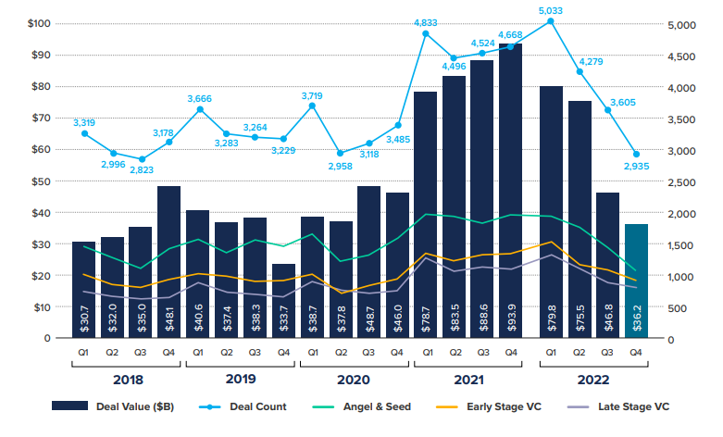
VC Funding (US)
Source: CVCA
Notes:
TONY We can see here that the although Canada has lower numbers than the US of course, it’s following the same overall trend.

Slide 8
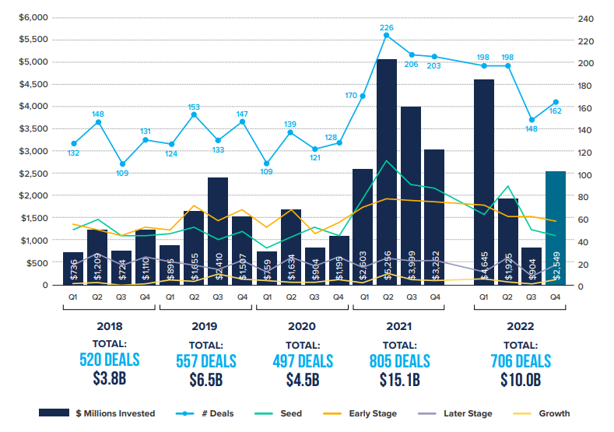
VC Funding (Canada)
Source: CVCA
Notes:
TONY

Slide 9
Venture Debt Funding (Canada)
Source: CVCA
Notes:
TONY - $664MM across 124 deals, most active year on record. Follows pattern of venture capital investments, showing that vd is highly correlated with venture investments

Slide 10
Is it right for your company?
Recent venture capital equity raise
High existing and/or planned growth rates
Meaningful market sizing
Scalable business model
IP and innovation-based businesses
Existing cash runway (+12 months)
Leveraging existing investor diligence
Notes:
THOMAS - So back to venture debt and its uses, you might be asking yourself, is it right for your company? This also goes hand in hand with what rbcx looks for in terms of due diligence

Slide 11
What else matters?
Lead investor analysis
VC fund nature (financial vs. strategic/corporate)
Fund size & vintage
Reserve strategy and follow-on capacity
Fund track record
Partner representation
Notes:
THOMAS - With every venture debt transaction, part of our diligence process includes an analysis of the company’s investors,

Slide 12
How is venture debt structured?
Senior Secured Term Debt (first ranking GSA)
Sizing is typically 20-40% of the latest equity round size
Interest bearing at a margin above prime rates
Includes a nominal warrant position
Four-year term on average
No financial covenants
Material Adverse Change (MAC) clause
Notes:
THOMAS - So now that we’ve made it through the diligence phase, how is venture debt actually structured?

Slide 13
How does it work?
Venture debt is interest only for 12-24 months (draw period)
Interest is only paid on what’s been drawn
Once draw period elapses, no further capital is advanced
No obligation to draw full amount
Balance typically amortizes monthly over a three year period until repaid
Typically repaid from future equity proceeds and/or refinanced
Notes:
THOMAS

Slide 14
What else do I need to know?
Engage with a Lender before or shortly (~12 months) after an equity raise
Work with a lender that has a broad platform able to scale with you
Understand your lender’s approval process and debt relationship
Replace with larger term facility at the close of the next round
Understand pathway to other financing products (working capital)
Partnering with experienced lawyers
Notes:
TONY

Slide 15
Thank you.

